Slide 1
WELCOME
Team 9
Reported By Team 9 – 15, Dec 2020

Slide 2
Team 9
Reported By Team 9 – 15, Dec 2020

Slide 3




OUR CLIENTS
黃傳霖
賴韜允
薛竣祐
毛文佐
D0746235
D0745806
D0745378
D0782807
Reported By Team 9 – 15, Dec 2020

Slide 4

Our project on AWS
建置一個 Web 網頁在遠端伺服器

Slide 5
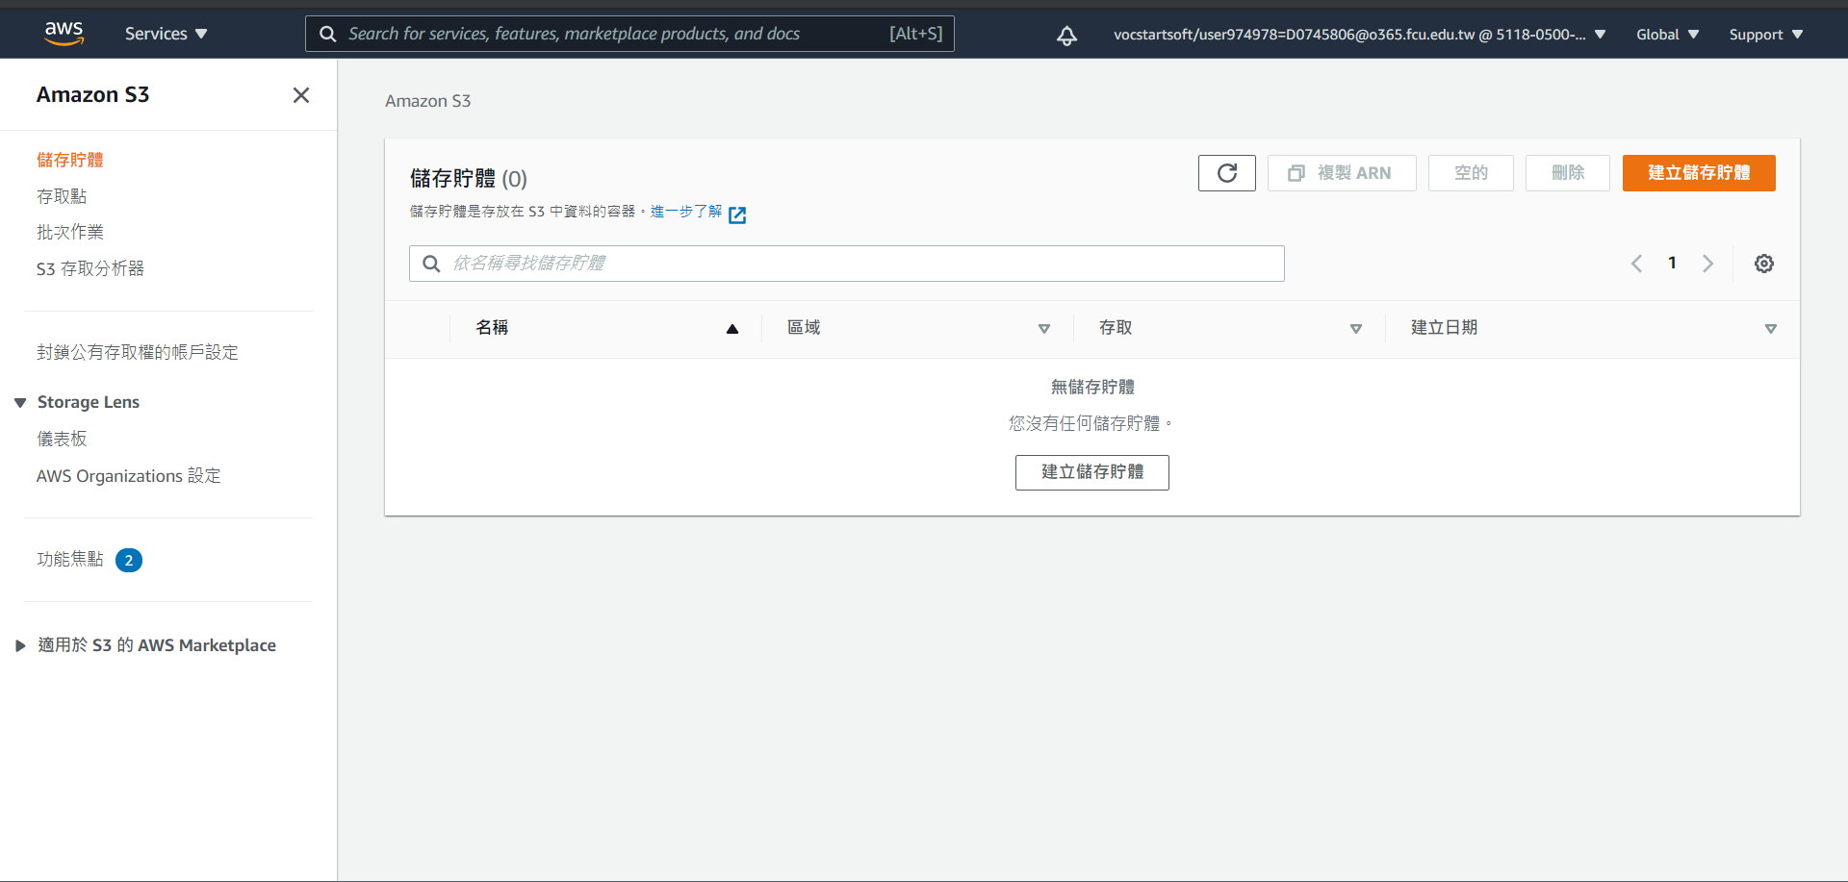
DETAILED PROCESS ON AWS
FOLLOW THE PROCESS
在 Console 搜尋 S3 並進入
點擊 Create bucket 進入創建頁面
Reported By Team 9 – 15 ,Dec 2020

Slide 6
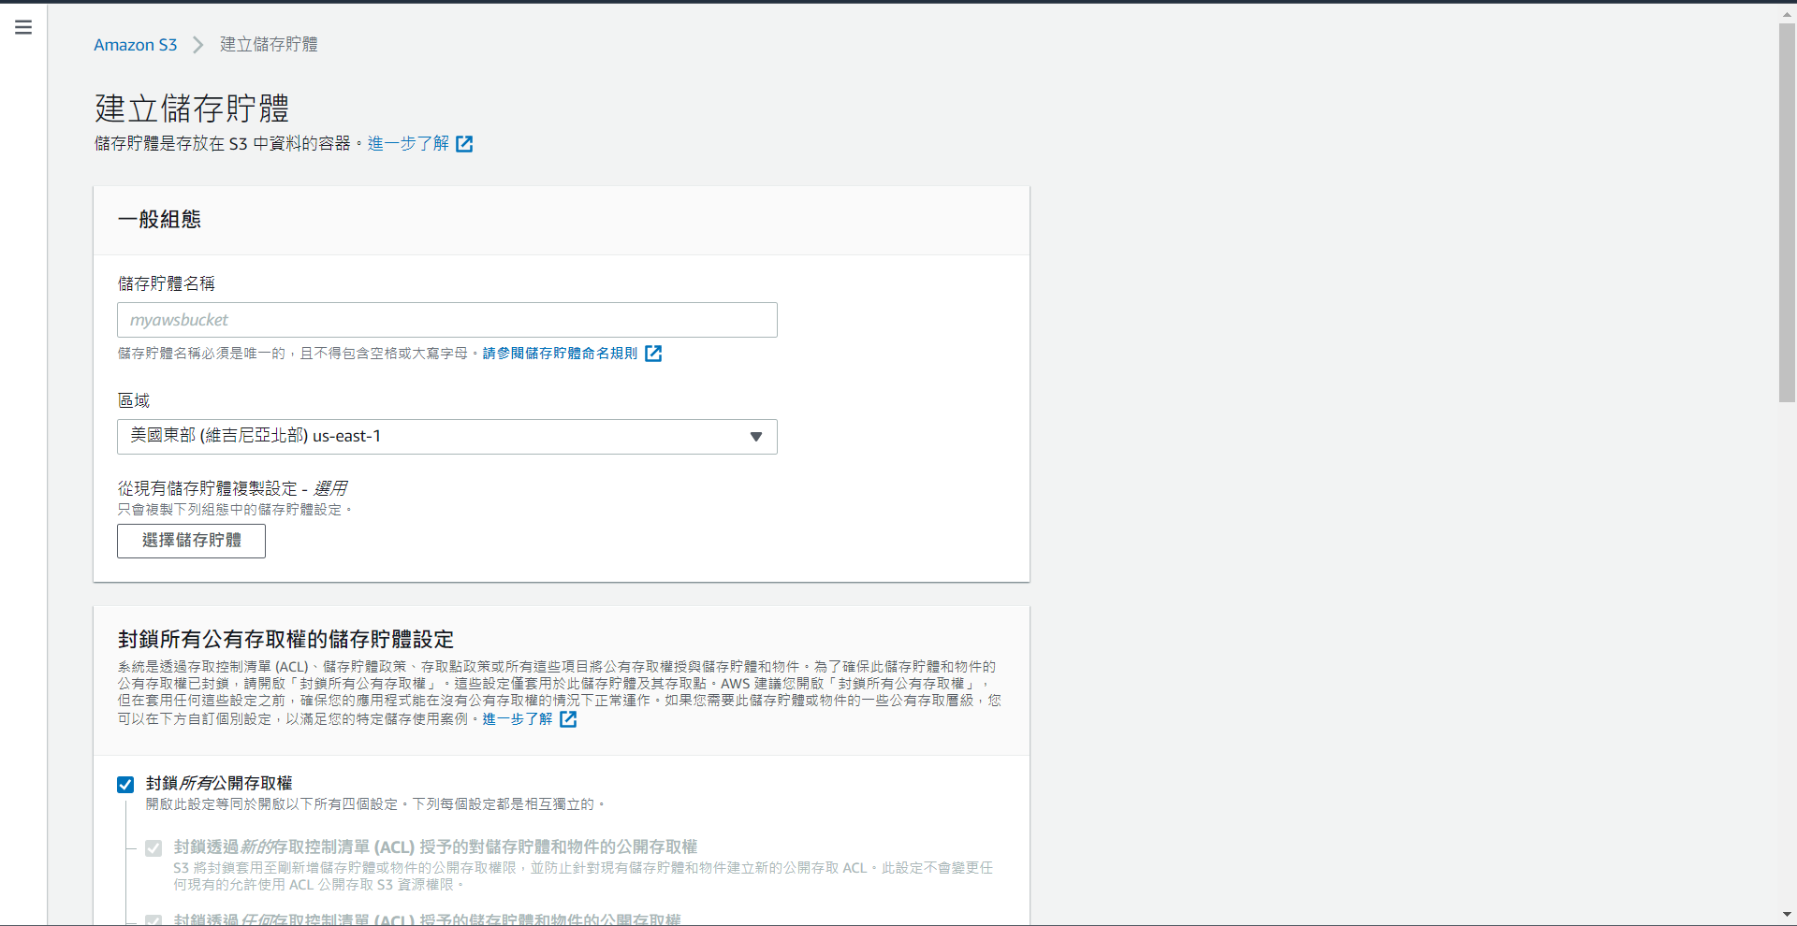
DETAILED PROCESS ON AWS
FOLLOW THE PROCESS
輸入 Bucket Name (此處須注意，Bucket為全球唯一)
把 Region 選擇在 US East (N. Virginia) us-east-1
把 Block all Public Access 取消勾選後按下建立儲存體
Reported By Team 9 – 15 ,Dec 2020

Slide 7
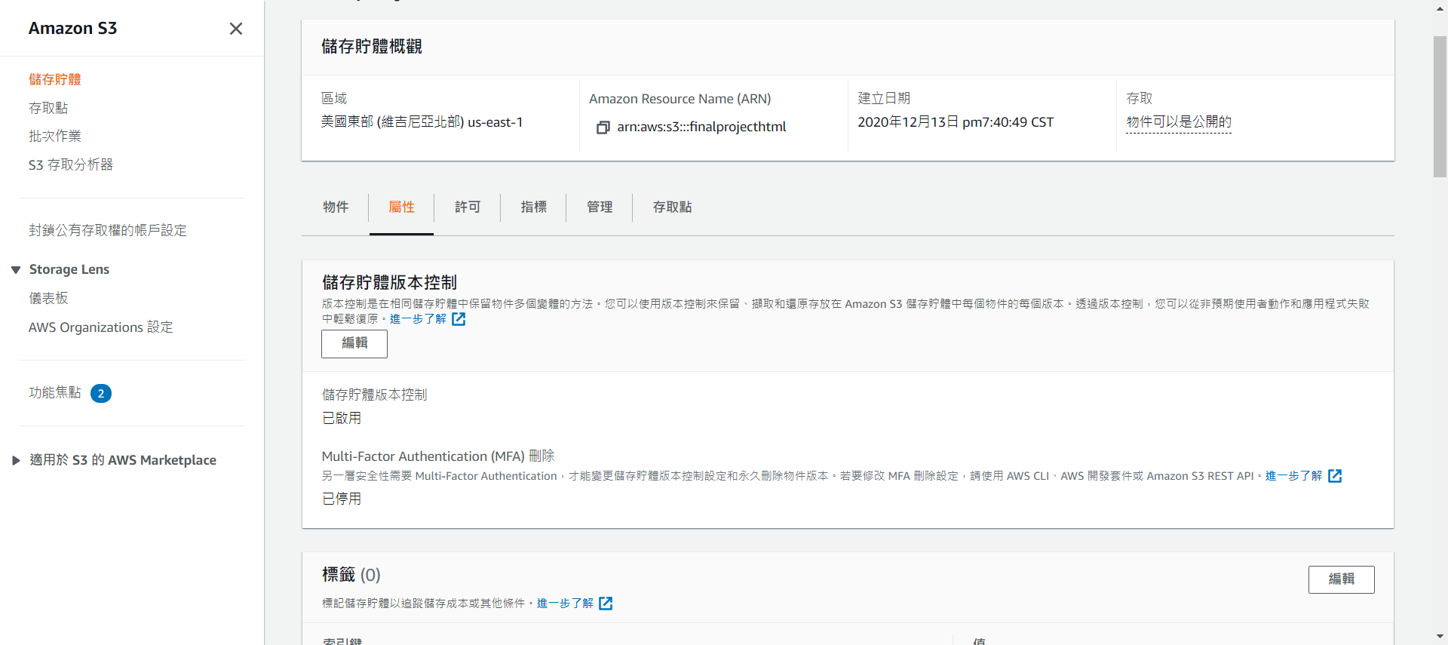
DETAILED PROCESS ON AWS
FOLLOW THE PROCESS
回到 Buckets 的頁面後，點下你 Bucket，進入後點 Properties
滾動到最下面，看到 Static website hosting，點下 Edit
Reported By Team 9 – 15 ,Dec 2020

Slide 8
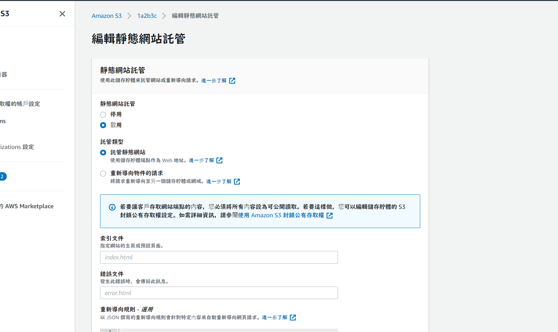
DETAILED PROCESS ON AWS
FOLLOW THE PROCESS
選取 Enable 後會看到新的選項
在 Hosting type 的部分選第一個 Host a static website
在 Index document 的地方輸入 index.html
在 Error document 的地方輸入 error.html
到最下面按下 Save changes
Reported By Team 9 – 15 ,Dec 2020

Slide 9
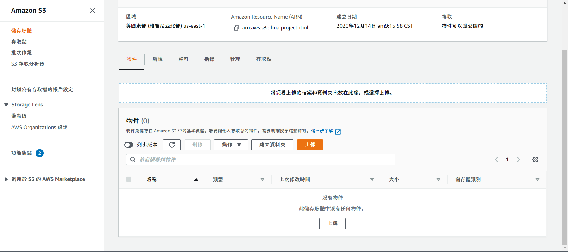
DETAILED PROCESS ON AWS
FOLLOW THE PROCESS
回到 Buckets 的頁面後，點下你的Bucket，進入後點 Objects 再點 Upload
點選 Add Files 把剛剛的檔案上傳，滾動到最下面點選 Upload
Reported By Team 9 – 15 ,Dec 2020

Slide 10
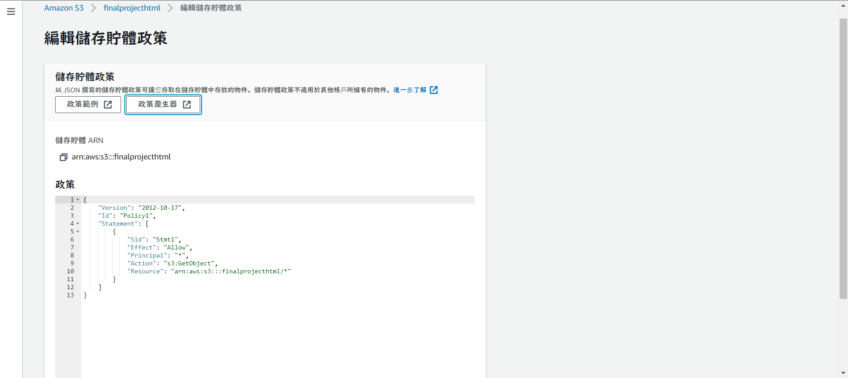
DETAILED PROCESS ON AWS
FOLLOW THE PROCESS
進入到 Edit bucket policy 頁面後，按下政策產生器
Reported By Team 9 – 15 ,Dec 2020

Slide 11
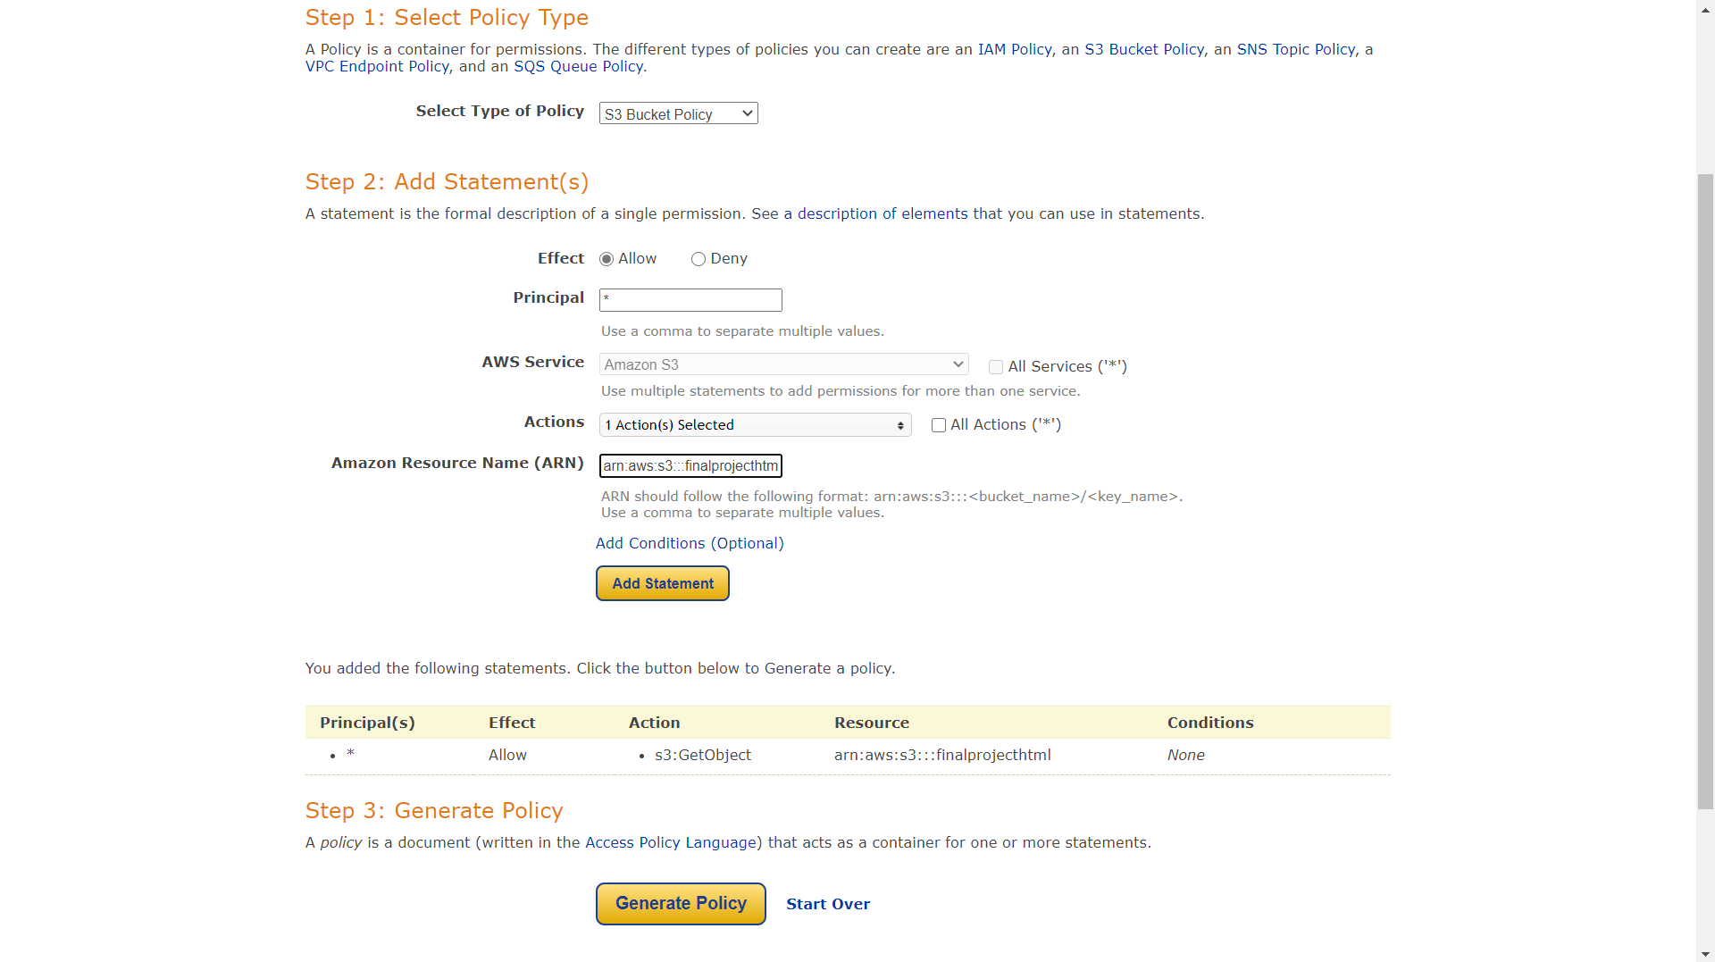
DETAILED PROCESS ON AWS
COMPANY MISSION EXAMPLE TITLE HERE
Policy type 選擇 S3
選擇你想要的 Action
輸入儲存體的 ARN，按下 generate policy
Reported By Team 9 – 15 ,Dec 2020

Slide 12
DETAILED PROCESS ON AWS
FOLLOW THE PROCESS
將產生出來的 Policy 貼上此段程式碼，按下儲存變更
Reported By Team 9 – 15 ,Dec 2020

Slide 13
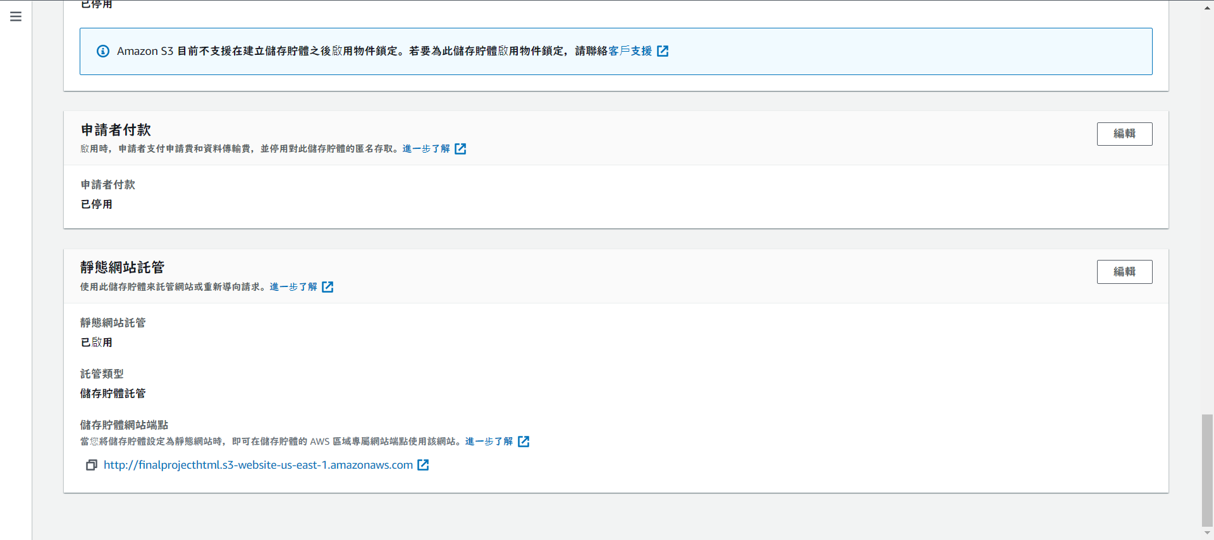
DETAILED PROCESS ON AWS
FOLLOW THE PROCESS
再來要測試網頁是否正常運作
回到 Buckets 的頁面後，點下你的 Bucket，進入後點 Properties 滾動到最下面會看到Static website hosting 有一組網址
http://finalprojecthtml.s3-website-us-east-1.amazonaws.com
Reported By Team 9 – 15 ,Dec 2020

Slide 14

USED TEC ON OUR PROJECT
Creating buckets – Create and name a bucket that stores data. Buckets are the fundamental containers in Amazon S3 for data storage.
S3
Storing data – Store an infinite amount of data in a bucket. Upload as many objects as you like into an Amazon S3 bucket.
Downloading data – Download your data or enable others to do so. Download your data anytime you like, or allow others to do the same.
Amazon S3 has a simple web services interface that you can use to store and retrieve any amount of data, at any time, from anywhere on the web.
This guide describes how you send requests to create buckets, store and retrieve your objects, and manage permissions on your resources. The guide also describes access control and the authentication process. Access control defines who can access objects and buckets within Amazon S3, and the type of access (for example, READ and WRITE). The authentication process verifies the identity of a user who is trying to access Amazon Web Services (AWS).
creeping Standard interfaces – Use standards-based REST and SOAP interfaces designed to work with any internet-development toolkit.
creeping Permissions – Grant or deny access to others who want to upload or download data into your Amazon S3 bucket. Grant upload and download permissions to three types of users. Authentication mechanisms can help keep data secure from unauthorized access.

Slide 15
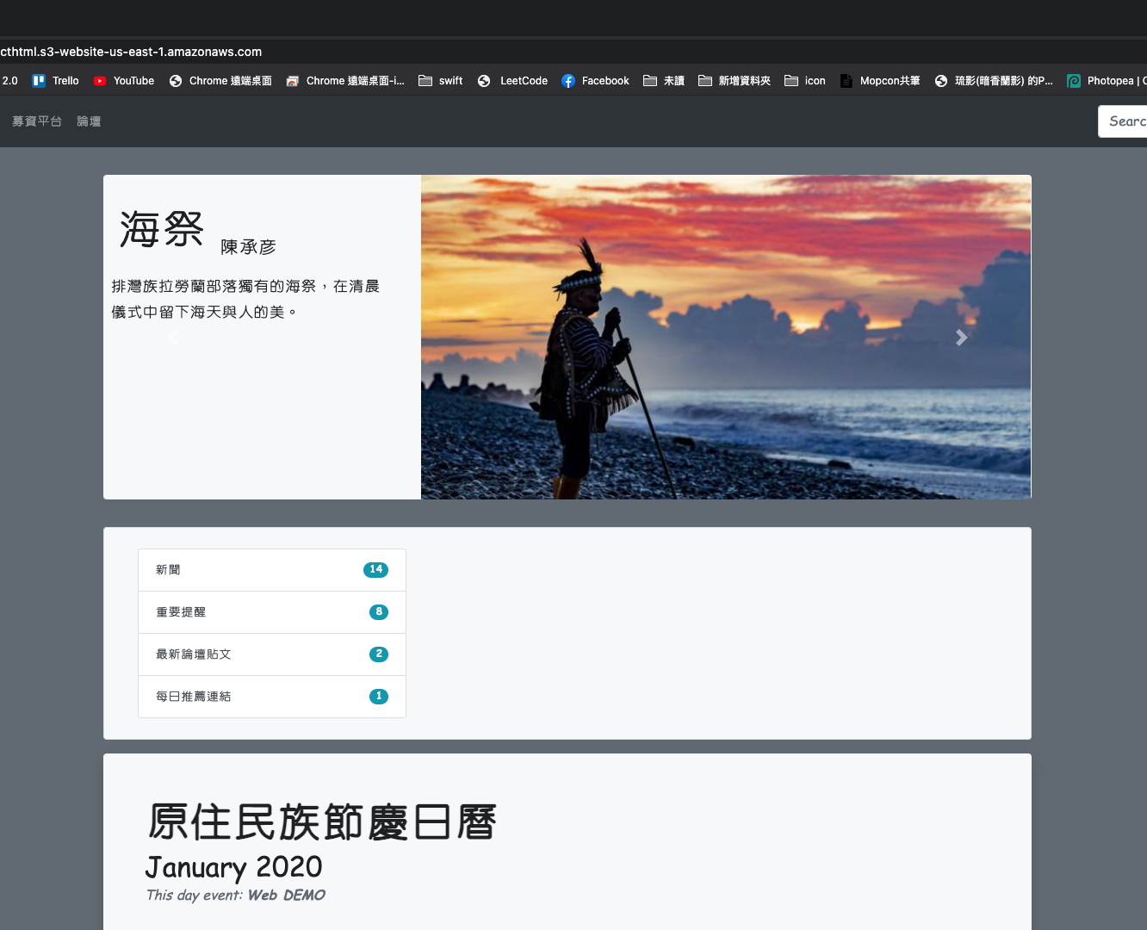
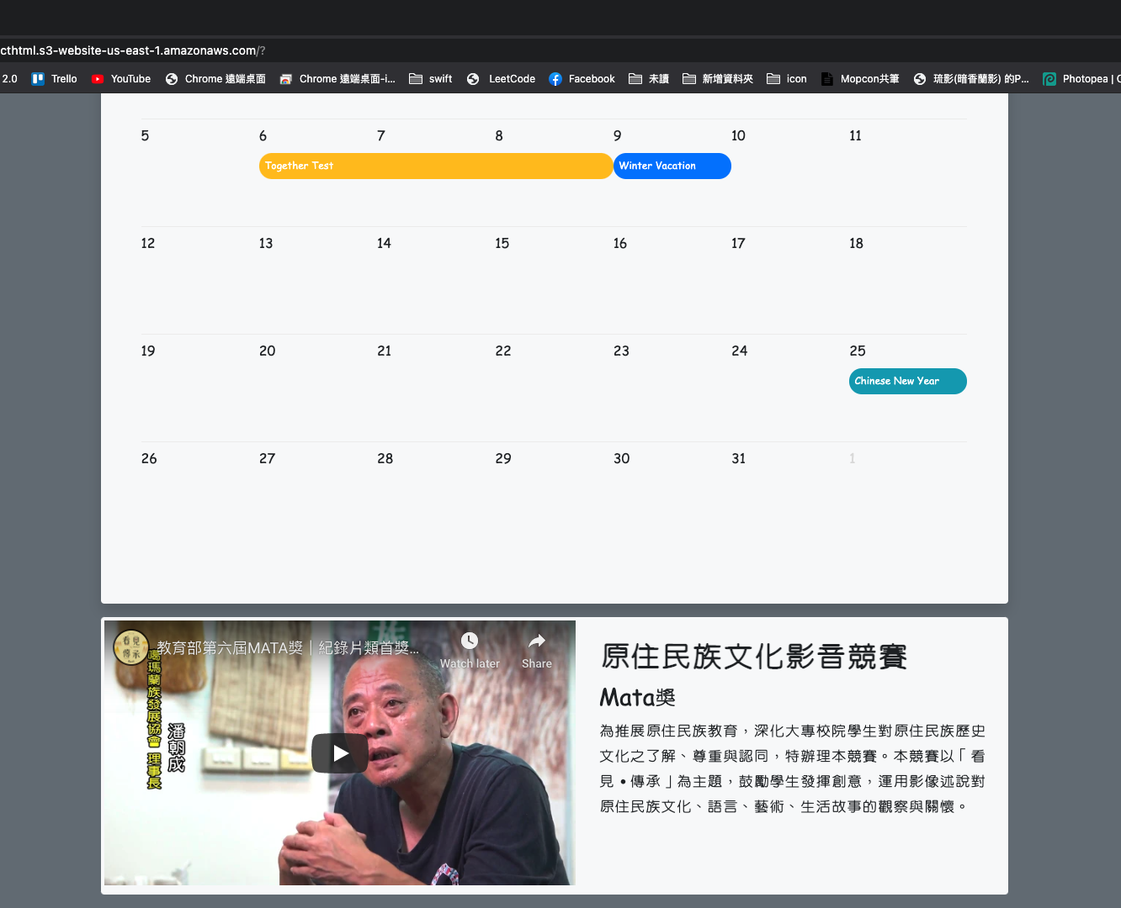
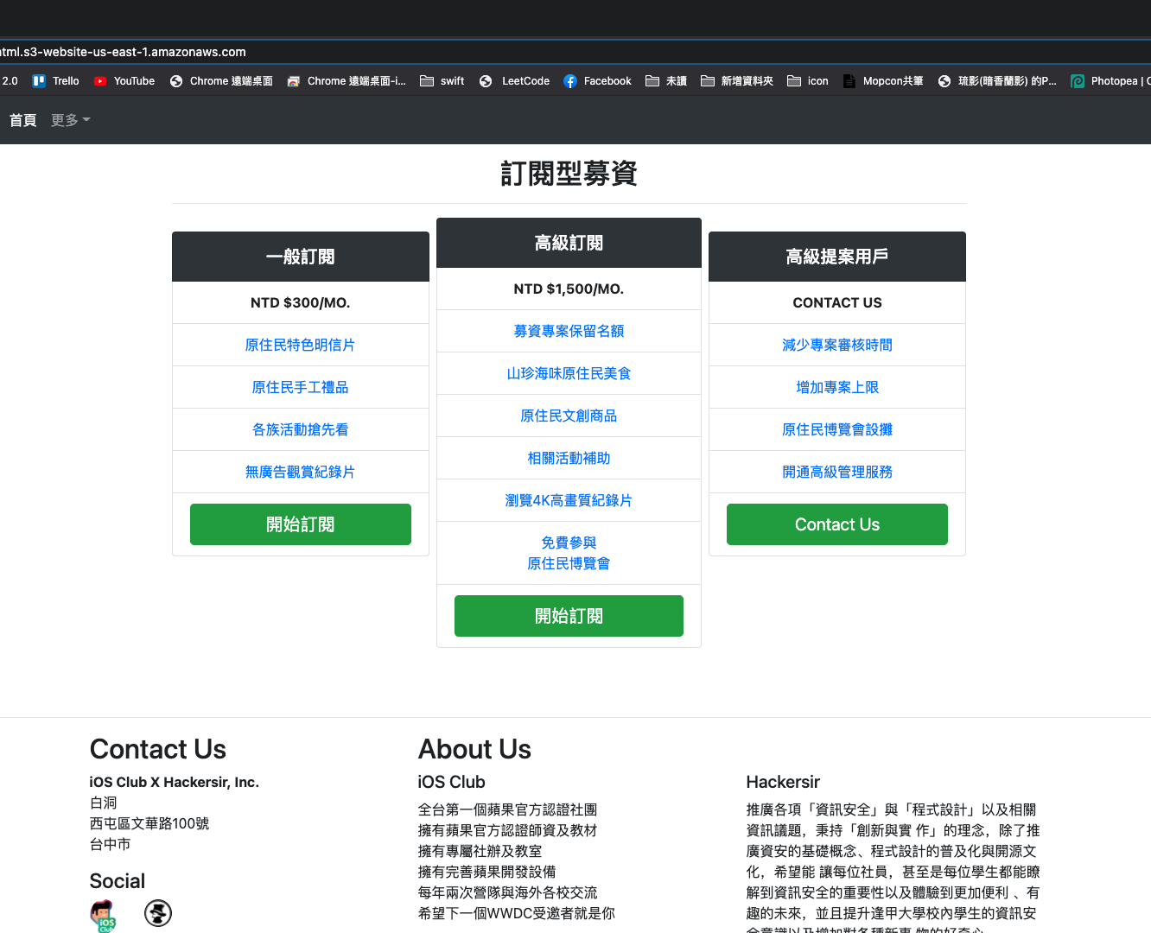
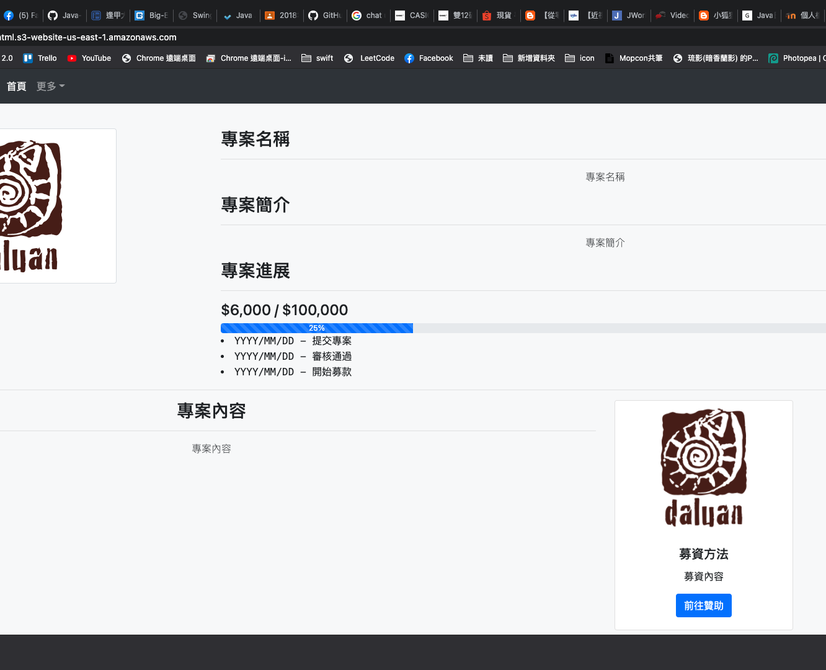
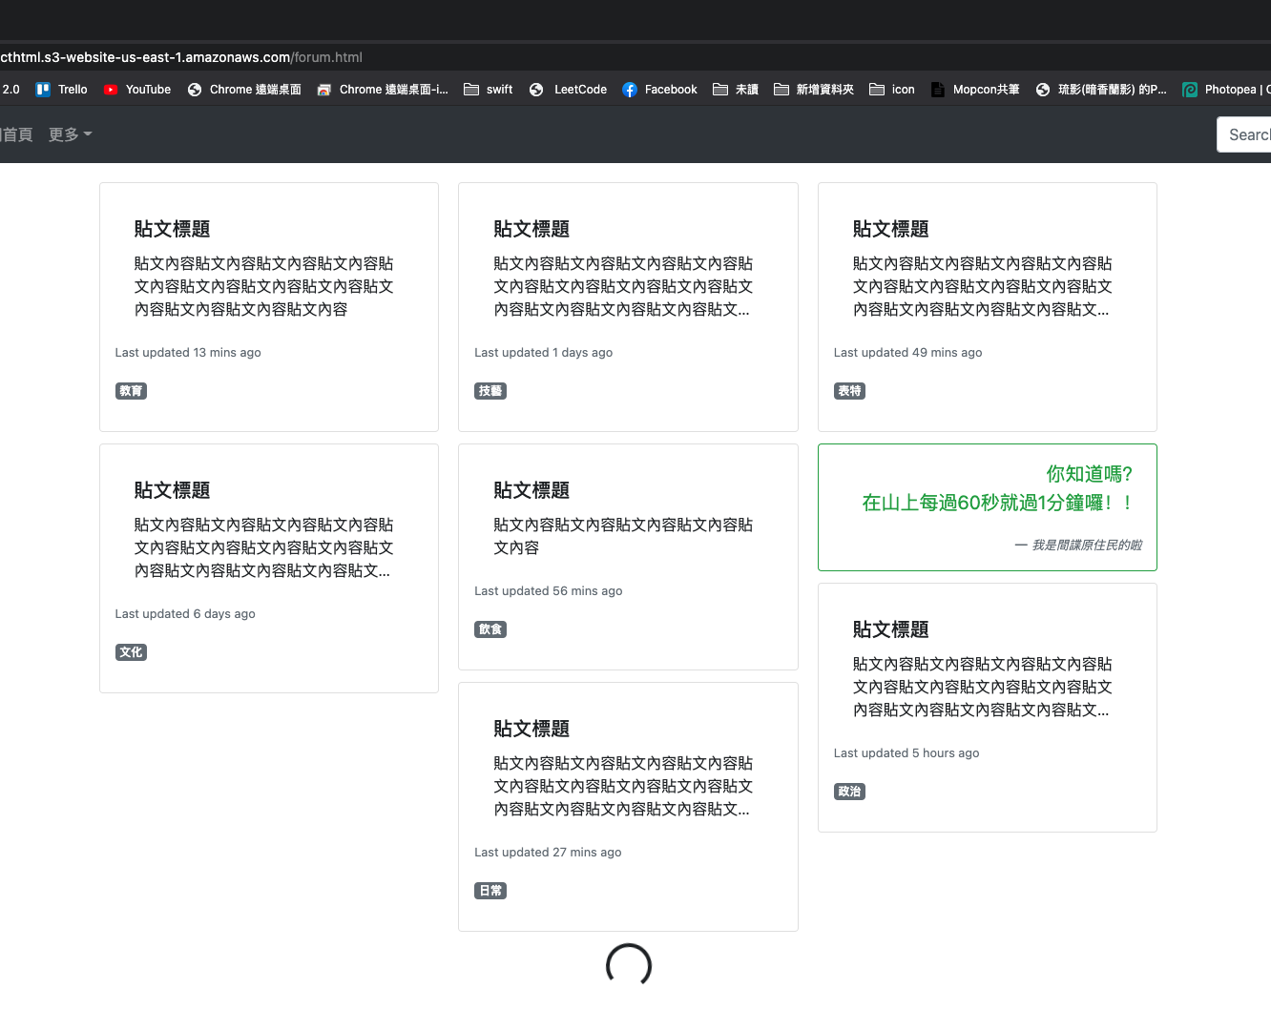
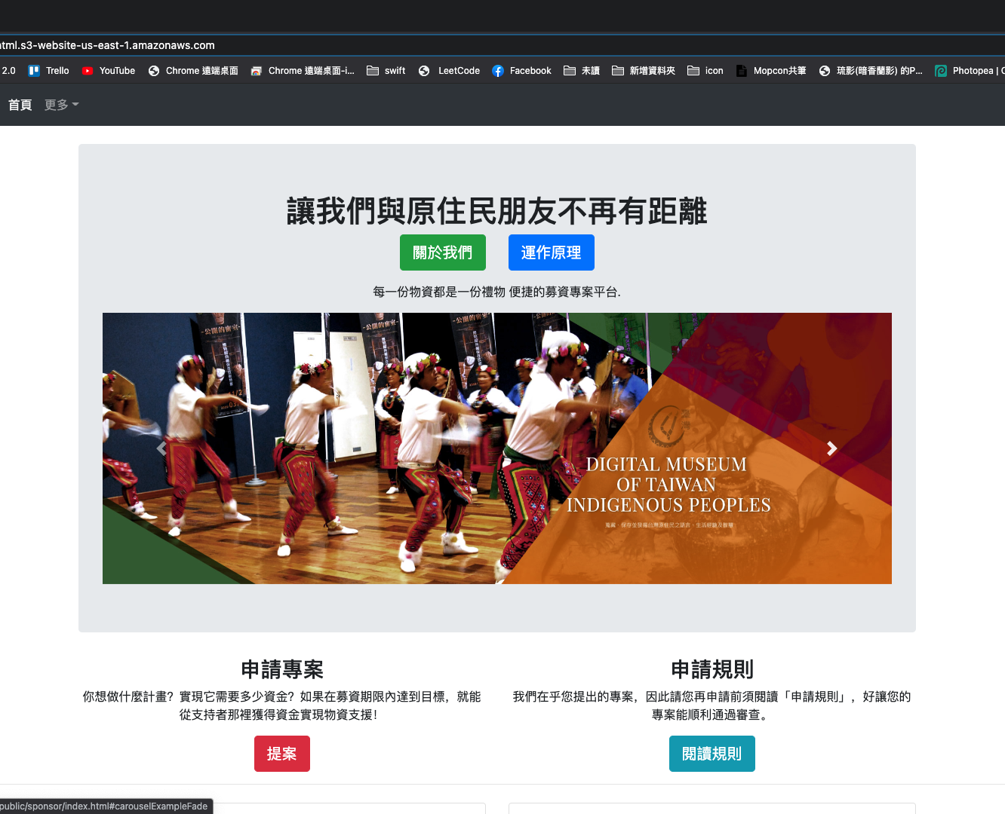
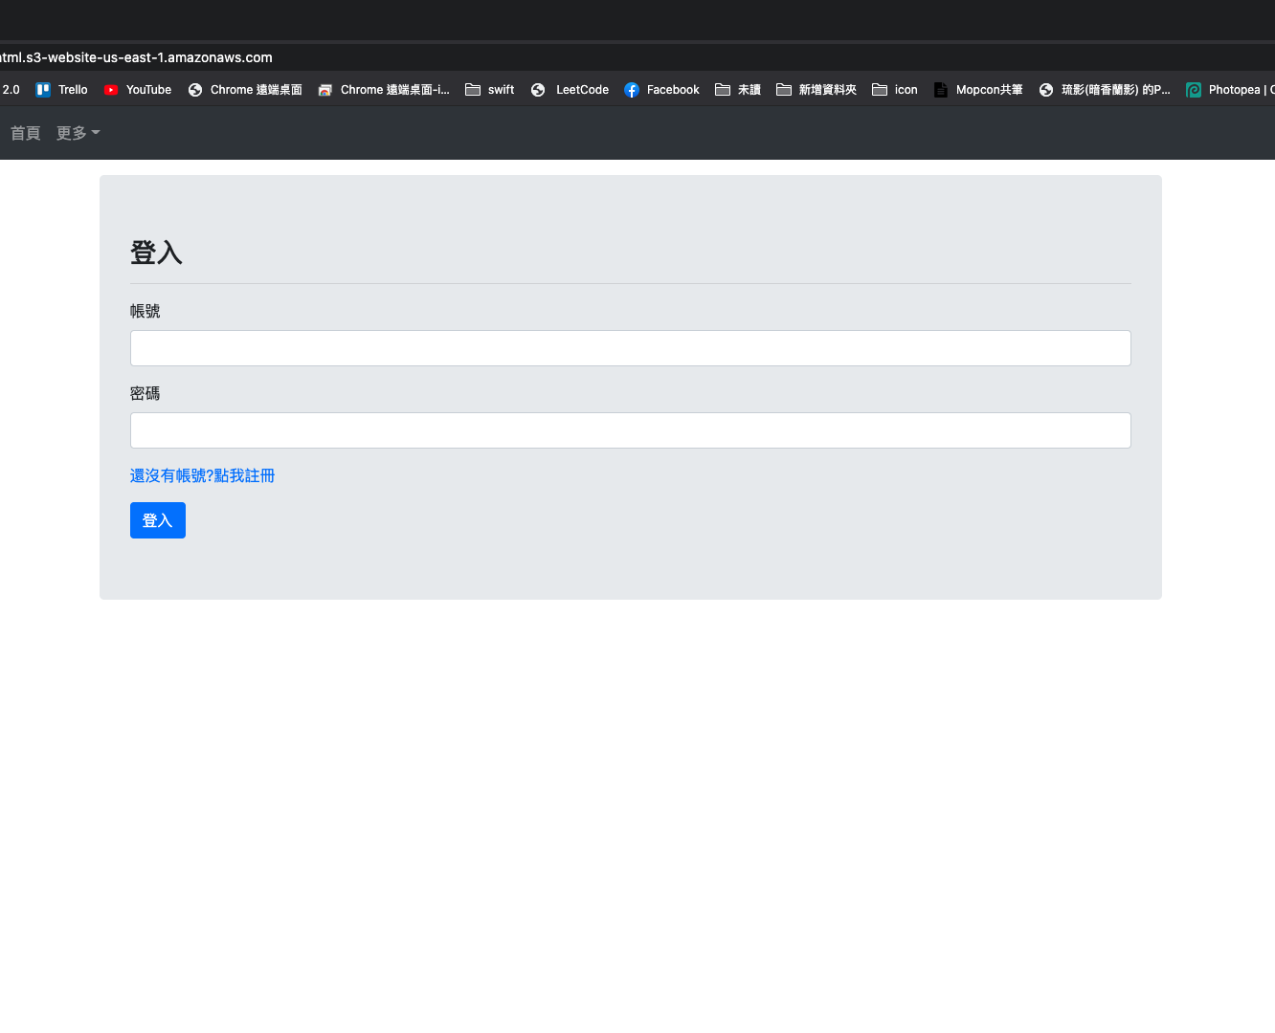
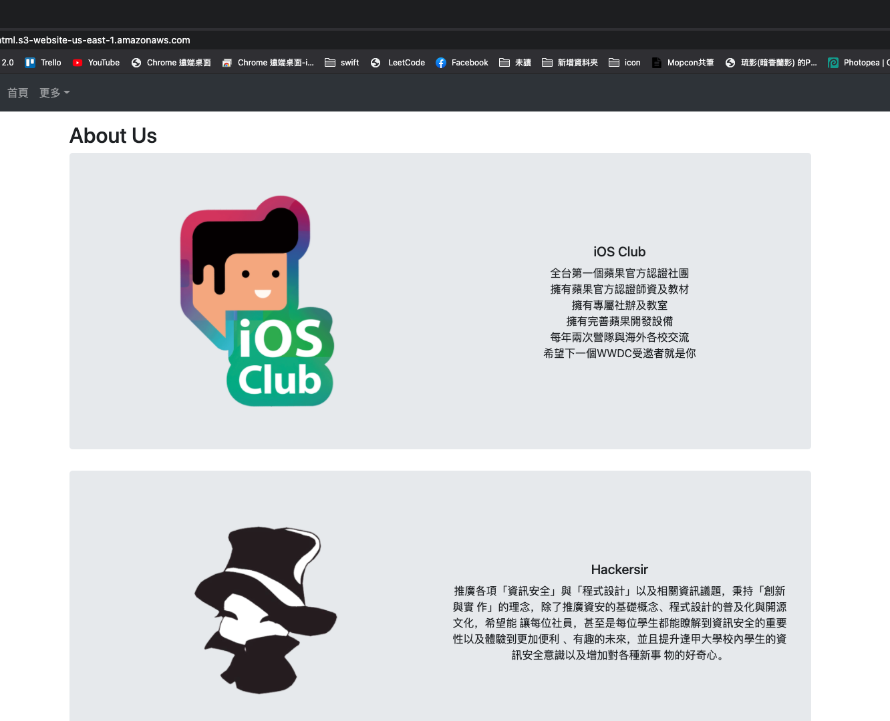
OUR PROJECT

Slide 16
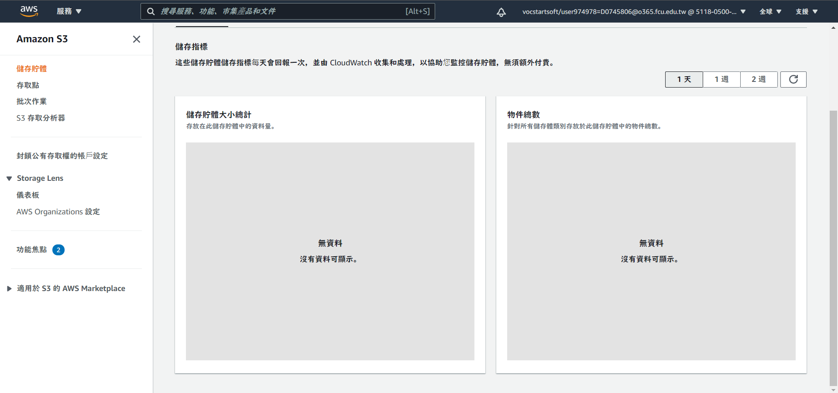
ESTIMATED REPORT
Reported By Team 9 – 15 ,Dec 2020

Slide 17
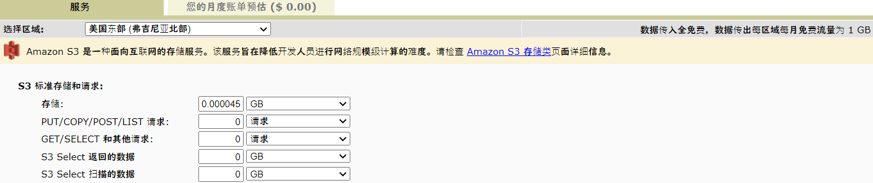
ESTIMATED REPORT
Reported By Team 9 – 15 ,Dec 2020

Slide 18
end
END.

